Slide 1

CMR COLLEGE OF ENGINEERING & TECHNOLOGY
Kandlakoya, Medchal, Hyderabad - 501401
Department of Computer Science and Engineering
Bharat Citizen Portal
Name of the student & Roll No.
K. SUSHMITHA-(20H51A0539)
E. PRIYANKA-(20H51A0589)
RAJNISH YADAV-(20H51A05P8)
Under esteemed guidance of
Guide Name : Ch. Raja Kishore Babu
Associate Professor

Slide 2
Outline
Abstract
Introduction
Research Objective
Problem Definition
Scope of the Project
Literature Review
Implementation of Existing system
Conclusion
References
Notes:
2

Slide 3
Abstract
Notes:
3

Slide 4
ABSTRACT
The proposed system is a web application which enables Citizens of India to avail the various centralized schemes sanctioned by the Government of India. The job of this system is to efficiently collect information and inform people about their status regarding their applications. The applicants explore utilizing features from the Government Sanctioned Schemes and utilized for procuring necessary data for further analysis for the citizens and availing various schemes by given them pointers. Then the research also includes a thorough evaluation of the applicants’ details and inform them. This system also aims to enhance the effectiveness of finding appropriate schemes for the applicant and helping genuine candidates for getting benefits of Schemes of the Government.
The project is mostly about detecting relevant information and the irrelevance in the applications to avail various resources from the government to the citizens using Big Data Analytics. The whole project is divided into two main phases, which are analyzing the applications with a suitable set of Machine Learning algorithms and then training machine and Deep Learning methods on derived features to recognize correct and wrong information. The website is built on interactive frontend web technology and Data Structures for extracting various types of information by executing backend code while dynamic analysis extracts feature during code execution or emulation on the data in database.

Slide 5
INTRODUCTION
Notes:
5

Slide 6
Introduction
Houses, pension, provident funds etc.. are the basic human requirements. Even after 70 years of independence, India is still grappling with the growing housing ,pension and other necessity problems , especially of the citizens. The rapid population growth in urban areas has led to acute housing shortages and poor urban living conditions. Continuous influx of rural population to cities in search of jobs is causing problems on urban housing. Providing a pucca house, pensions, provident funding etc.. with basic amenities to all houseless households.
Housing affordability is currently a prominent concern in India, specially in urban areas. Globally, there have been several interventions which have aimed to provide affordable housing solutions for all. India’s growing economic status, the country has 78 million homelessness people . To tackle the problem of homelessness the government launched many schemes in recent years and tried to bridge the gap between demand and supply of houses. There are several government schemes that have been launched over past few years.
Notes:
6

Slide 7
Research Objective
Notes:
7

Slide 8
Research objective
There are three main objectives of Bharath Citizen Portal. They are :
Helping citizens to avail their own houses.
Guiding pensioners to get the benefits they deserve.
Providing citizens the easy of getting their remaining income through home.

Slide 9
Problem Definition
Notes:
9

Slide 10
Problem Definition
The proposed system aims to help citizens seek the various schemes provided by the government. There are various schemes which work on devoting finance, housing, pensions etc., The system is a guide to citizens within the loop and mess of the schemes and facilities that are sanctioned by the government. The citizens mostly go along the way they are told to without ever knowing that they are either getting close to availing or getting rejected. The system covers up such loop hole in the monitoring system of the government and help citizens. These benefits are for the citizens but the lack of awareness of schemes and the ways to avail them renders such ideas useless and the system would reduce such inefficiencies to the at-most extend possible.

Slide 11
Scope of the project

Slide 12
Scope of the project
The scope of the project for the Bharat Citizen Portal should align with the overarching goal of improving citizen-government interactions, enhancing transparency, and providing convenient access to essential services. Providing proper services like education loan, provident funds, pensions, home loans to
Economically Weaker Sections (EWS)
Low-Income Groups (LIG)
Middle-Income Groups (MIG)
Slum dwellers
People living in dilapidated houses
.

Slide 13
Literature Review

Slide 14
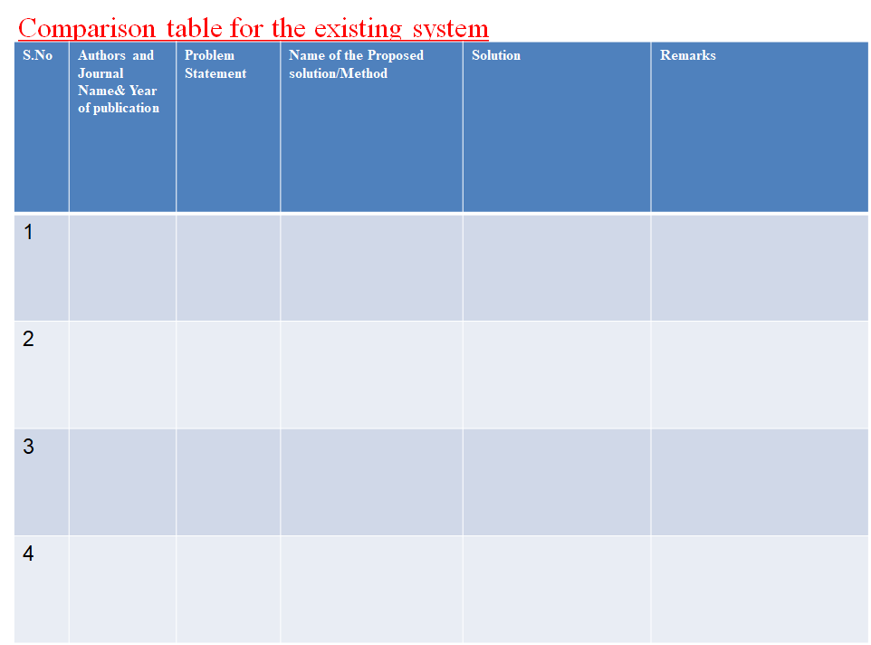
C. A, S. V. K, S. R. B and M. Ch,
Interdisciplinary Approaches in Technology and Management for Social Innovation (IATMSI)
2022
The Pradhan Mantri Awas Yojana (PMAY) was established with the goal of providing affordable homes to the poorer sectors of society.
Representation of Status of Buildings under PMAY Scheme
We come up with the idea that can be implemented on national scale. It is mostly based on Machine Learning techniques (Data processing) and representation of housing data on map with the help of GIS coordinates of the building.
It might allow for frequent updates and cost-effectiveness analysis That might be useful in a variety of situations. For this study, we have taken the areas where the PMAY scheme is implemented.
D. Chenge, Z. Xiao, H. Jingxi, W. Sitong and T. Pei
International Conference on Intelligent Computing and Signal Processing (ICSP)
In the conventional gesture recognition algorithm such as Support Vector Machine (SVM) and Dynamic Time Warping (DTW), the calculation time and accuracy.
Gesture Classification Algorithm Based on SVDD-EPF
This method mainly uses effective interception data to replenish the length of different gesture data to the same, and generates a continuous and smooth function. On this basis, the SVDD algorithm acts on the extreme points of the function.
The results show that the gesture recognition rate of the SVDD-EPF algorithm is higher than that of the traditional SVM algorithm, that is, a better recognition state can be achieved. If it is applied to a mobile phone unlock, it is expected to become a new generation of unlock mode.
D. S. Harsha, S. Praneetha, V. Swetha, P. Dinesh and K. S. Vani
Global Conference for Advancement in Technology (GCAT)
During More than 10.5 million individuals in India live in kutcha houses and are described by helpless everyday environments, the consistent convergence
Evaluation of Support to Beneficiaries Under PMAY using Clustering Techniques
To improve this Government of India has as of late dispatched a moderate lodging plan, Pradhan Mantri Awas Yojana – Housing for All (Urban) Mission” for metropolitan territory is being executed during 2015-2022.
The entire process aims at understanding all these activities by clustering (Machine Learning technique) of housing data using GIS coordinates and mapping these clusters to disclose the stages of houses at corresponding location/area.
W. -E. Chen, C. -C. Chiu, Y. -B. Chang and Y. -W. Chiang
International Wireless Communications and Mobile Computing Conference (IWCMC)
Recently, the key issues of Machine-to-Machine (M2M) communications also known as Machine Type Communications (MTC) are widely discussed.
An Enhanced Port Forwarding (EPF) solution for NAT traversal in 3GPP Machine Type Communications
However, the private IPv4 addresses are used for current configurations. Thus, the Network Address Translation (NAT) traversal problem should be resolved for MTC in 3GPP architecture. In this paper, we introduce the architectures and call flows of three NAT traversal solutions defined in 3GPP 23.888.
Then we propose an Enhanced Port Forwarding (EPF) solution to minimize the impacts on the MTC device and 3GPP core network. Finally, we analyze and compare the proposed EPF solution with the existing solutions.

Slide 15
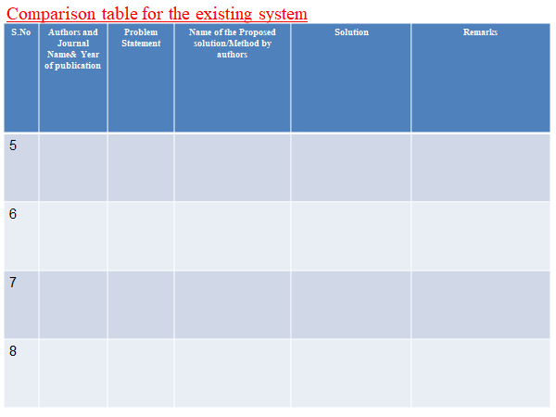
Y. Wang and J. Yin
IEEE Congress on Evolutionary Computation (CEC)
Research on synthetic aperture radar (SAR) scene matching in the aircraft end-guidance has a significant value for both research and real-world application.
Intelligent search optimized edge potential function (EPF) approach to synthetic aperture radar (SAR) scene matching
The conventional scene matching methods, however, suffer many disadvantages such as heavy computation burden and low convergence rate so that these methods cannot meet the requirement of end-guidance system in terms of fast and real-time data processing.
It might allow for frequent updates and cost-effectiveness analysis That might be useful in a variety of situations. For this study, we have taken the areas where the PMAY scheme is implemented.
S. Kim, H. Oh and C. Kim
International Conference on Big Data and Smart Computing (BIGCOMP)
CISCO VNI predicted an average annual growth rate of 69.1% for mobile video traffic between 2013 and 2018 and accordingly much academic research related to initiated.
ePF-DASH: Energy-efficient prefetching based dynamic adaptive streaming over HTTP
In video streaming, Adaptive Bitrate (ABR) is a streaming technique in which a source video is stored on a server at variable encoding rates and each streaming user requests the most appropriate video encoding rate from the server considering their channel capacity or signal power.
CISCO VNI predicted an average annual growth rate of 69.1% for mobile video traffic between 2013 and 2018 and accordingly much academic research related to video streaming has been initiated.
J. Cong, C. Li, F. Liu and D. Chu
International Conference on Service Science (ICSS)
How to recommend appropriate pension services to the elderly is an active research problem in health care fields in recent years.
EPF: An Elderly Personalization Features Based Collaborative Filtering Algorithm for Pension Service
In the algorithm, personalized requirements form the elderly customers can be obtained by the classification of pension services. Based on classification results, the customer personalization features model can be built, in which customers are divided into several groups
Finally the CF algorithm can be employed to detect appropriate pension services to the elderly. The experiments show that the algorithm can improve the accuracy of predicted ratings, as well as the satisfaction of elderly customers.
O. Putyatina
International Conference - The Experience of Designing and Applications of CAD Systems in Microelectronics
This paper discusses the problems of Ukrainian new pension system, non-state pension funds in particular.
Designing an Information System for Pension Fund Management
The paper is concerned with development of mathematical methods and models that would form a base of management information systems.
The new pension system has been lawfully ratified only three years ago and is still developing, that is why this paper is very important.

Slide 16
Literature Review
Review literature on e-participation through citizen portals, including online consultations, citizen feedback mechanisms, and collaborative governance.
Provide employment to skilled workers who are jobless.
To reduce the communication gap between the customer and the worker.
Provide convenient services to the customers.
Reducing the service cost and improving service.

Slide 17
Implementation of Existing system

Slide 18
Implementation of Existing system
They are few existing solutions by government. The government schemes are
Vidya laxmi yojana : This scheme is used to provide loans on education. The schemes offers financial assistance to students .
Employees provident funds : This encourages individulas to save funds for thier retirement. These funds can be accessed after retirement .
Atal pension yojana : Atal pension yojana is designed to provide a pension plan that is affordable and accessible to individuals in the organized sectors.
Pradhan mantri awas yojana : It is used to provide subsidy for home loans.
to access the availability and quality of housing.

Slide 19
CONCLUSION

Slide 20
Conclusion
The Bharath Citizen Portal has emerged as a transformative platform that has streamlined access to key government schemes, including Pradhan Mantri Awas Yojana (PMAY), Atal Pension Yojana (APY), Central Sector Interest Subsidy Scheme, and Employee Provident Funds (EPF). It has had a profound impact on the socio-economic landscape of India, addressing critical areas of housing, retirement security, higher education, and financial stability. The inclusion of the Central Sector Interest Subsidy Scheme has highlighted the government's commitment to education and skill development. The simplified application process has empowered more students to pursue higher education, enriching the nation's human capital and contributing to socio-economic growth.
In summary, the Bharath Citizen Portal has demonstrated the government's dedication to enhancing the lives of its citizens. It has simplified administrative processes, reduced inefficiencies, and increased transparency in delivering public services.

Slide 21
References

Slide 22
References
A_Study_on_Public_Perception_on_Pradhan_Mantri_Awas_Yojana
https://ieeexplore.ieee.org/document/9934357/
https://financialservices.gov.in/pension-reforms-divisions/Atal-Pension-Yojana
https://www.epfindia.gov.in/site_en/index.php
https://ieeexplore.ieee.org/document/4297597/
https://pmaymis.gov.in/
https://ieeexplore.ieee.org/document/9587732

